Slide 1
CS 573 Advanced Software Engineering
Syllabus

Slide 2
Instructor
Dianxiang Xu, Ph.D.
Professor
MEC 302A
dianxiangxu@boisestate.edu
208-426-5734
Office hours:
MoWe 1:30PM - 3:30PM, 4:15-5:30pm or by appointment, MEC 302A

Slide 3
Course Catalog
“A study of selected aspects of contemporary software development methodology. Topics are taken from recent research articles. These topics include: definition of user requirements, formal specification of solutions, design and implementation techniques, validation and testing, verification, maintenance, and reuse.”

Slide 4
Prerequisites
Course Prerequisite(s):
CS 471 or regular admission to the program
Object-oriented programming in Java or other languages

Slide 5
Materials
Steve McConnell. Code Complete: A Practical Handbook of Software Construction. 2nd Edition. Microsoft Press, 2004.
Robert C. Martin, Agile Software Development: Principles, Patterns, and Practices, Pearson Education, Inc, 2003.
Bertrand Meyer. Object-Oriented Software Construction, 2nd Edition, Prentice-Hall PTR, 1997.
Other texts and publications to be announced in class.

Slide 6
Materials – cont’d
Presentations from recent 5 years of the following journals and conference proceedings
IEEE Transactions on Software Engineering
ACM Transactions on Software Engineering Methodologies
Proceedings of IEEE/ACM International Conference on Software Engineering (ICSE)
Proceedings of ACM SIGSOFT Symposium on the Foundations of Software Engineering (FSE)
Proceedings of IEEE/ACM International Conference on Automated Software Engineering (ASE)

Slide 7
Assessment Components
Class Participation
Assignments
Posted on blackboard.
2 weeks to complete
Your responsibility to find out assignments.
To be turned in via blackboard
If the campus network is down, you will not be penalized.
No late assignments.
Topic Presentation
Exams

Slide 8
Topic Presentations
Contents of Presentation
Problem definition/motivation
What are the challenges,
Literature surveyed by the authors
Specific theory/technique developed
Strengths and weaknesses.
Time: 75 minutes, including Q/A
Good understanding;
Be well-prepared

Slide 9
Exams
Open book, but timed.
Based on lectures, assignments, and presentations.
Schedule
Midterm: Monday, March 9
Final: BSU’s schedule

Slide 10
Grading
Assignments 40
Presentation 15
Midterm 20
Final Exam 25
Total 100

Slide 11
Grade Scale
A 90% - 100%
B 80% - 89%
C 70% - 79%
D 60% - 69%
F 59.9% and below

Slide 12
Academic Honesty Statement
Cheating and other forms of academic dishonesty run contrary to the purpose of higher education and will not be tolerated in this course.
Please be advised that, when the instructor suspects plagiarism, the Internet and other standard means of plagiarism detection will be used to resolve the instructor’s concerns.
All forms of academic dishonesty will result in a grade of zero, and possibly further disciplinary action.

Slide 13
What Is Software Engineering?
Problem: software crisis -- software is delivered
Late (schedule)
Over budget (cost)
With residual faults (quality)
Solution: engineering process
Planning, requirements, design, implementation, testing, maintenance
Process management

Slide 14
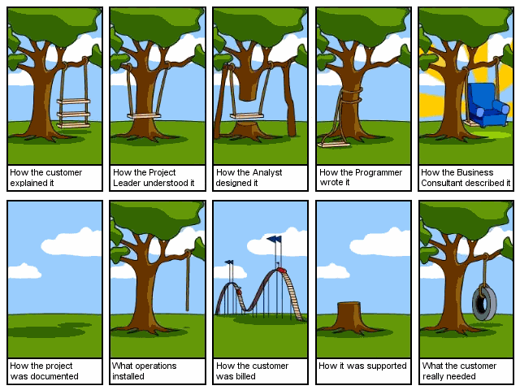
Software Development Nightmare

Slide 15
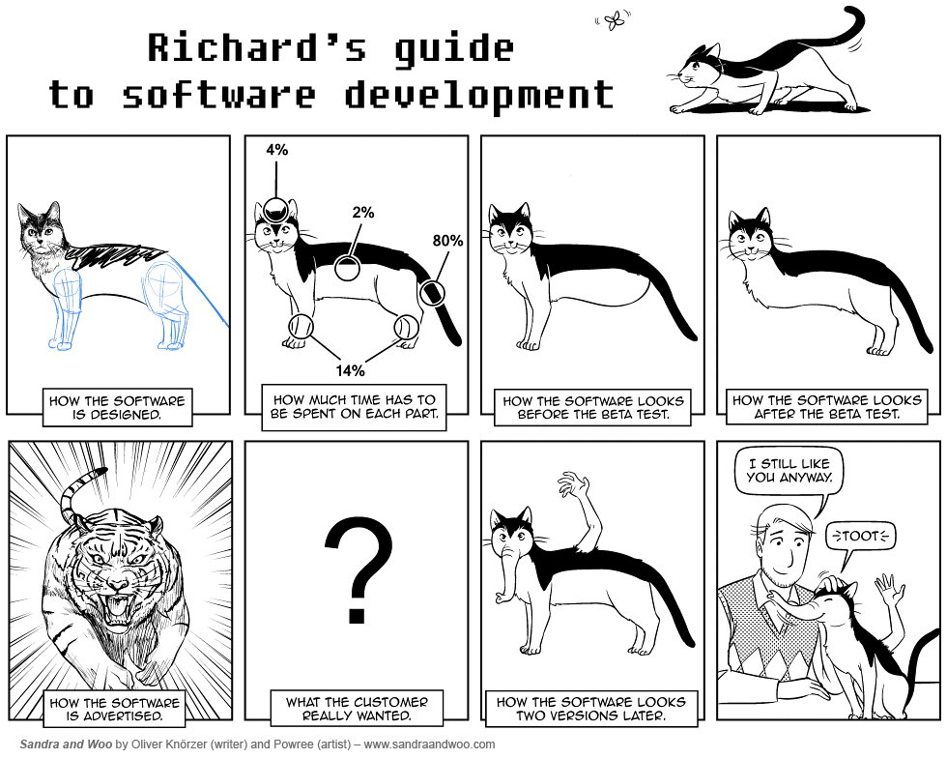

Slide 16
Overview of Topics (Tentative)
Advanced Design Principles
Advanced Testing Techniques
Formal Modeling and Verification
Debugging and Code Tuning

Slide 17
Advanced Design Principles
Class Design
Design by Contracts vs Defensive Programming
Inheritance
Agile Design Principles
Refactoring
Design Patterns

Slide 18
Advanced Testing Techniques
Mutation Testing
Mutation and the RIP model
Test Automation and Oracles
Specification (Contracts)-Based Testing
Syntax Testing
Model-Based Testing

Slide 19
Formal Modeling & Verification
Finite State Machines
Petri Nets
Model Checking

Slide 20
Debugging & Code Tuning
Scientific Approach to Debugging
Automated Fault Localization
Tuning for Performance Improvement

Slide 21
Homework
Find papers for topic presentations
IEEE Transactions on Software Engineering
ACM Transactions on Software Engineering Methodologies
Proceedings of IEEE/ACM International Conference on Software Engineering (ICSE)
Proceedings of ACM SIGSOFT Symposium on the Foundations of Software Engineering (FSE)
Proceedings of IEEE/ACM International Conference on Automated Software Engineering (ASE)
Half before midterm

